Slide 1
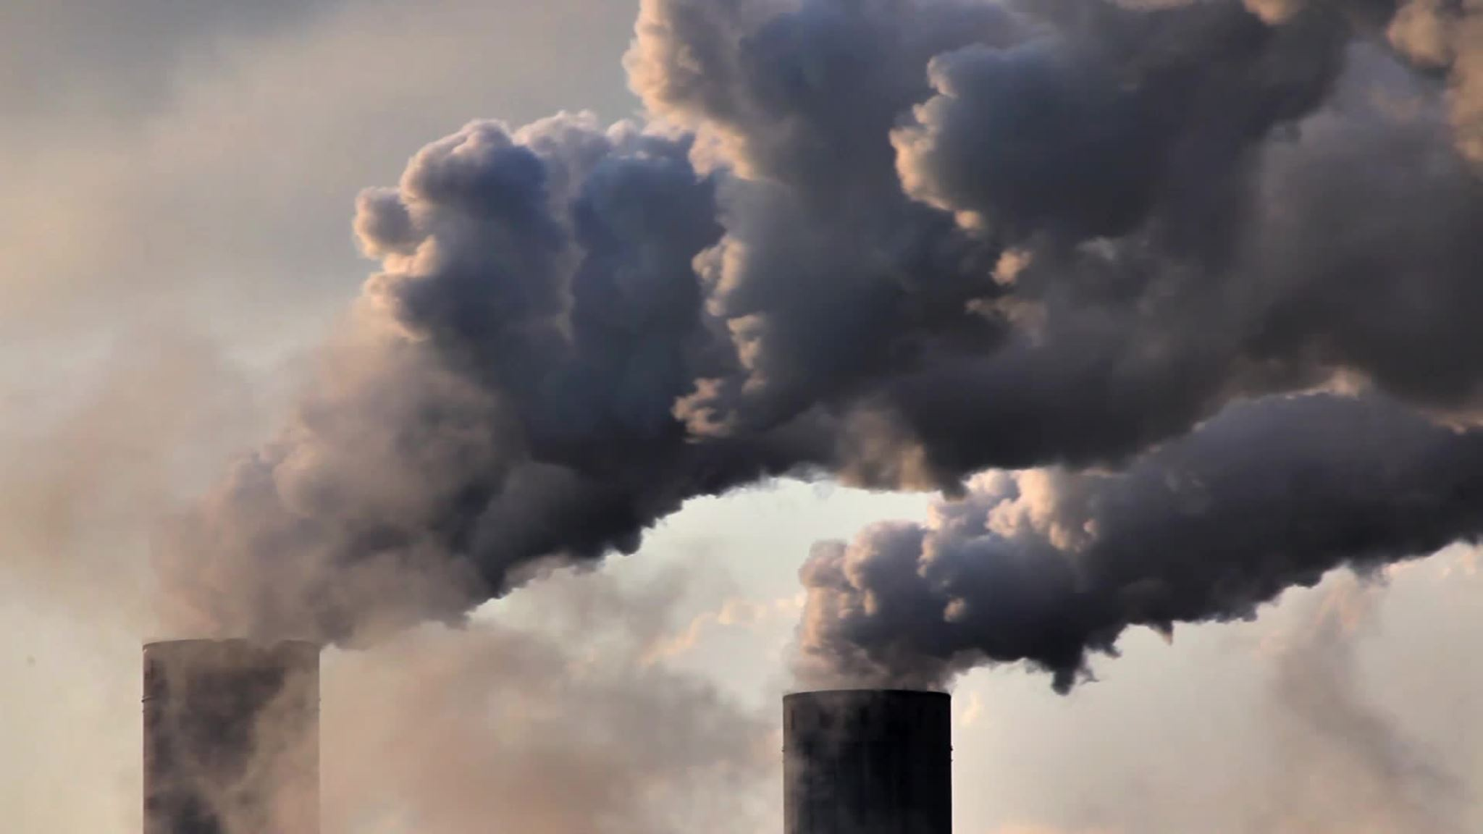
Analyzing CO2 Emissions -27/11/2023
Sakthi Vel S
Shashank HV
Pankaj Chouhan

Slide 2
Definition of CO2 emissions
The release of carbon dioxide (CO2) into the atmosphere as a result of human activities, such as
Energy Production
Industry
Transportation
Deforestation

Slide 3
Impact of CO2 Emissions
Global warming and climate change
Sea level rise
Extreme weather events
Effects on ecosystems and biodiversity

Slide 4
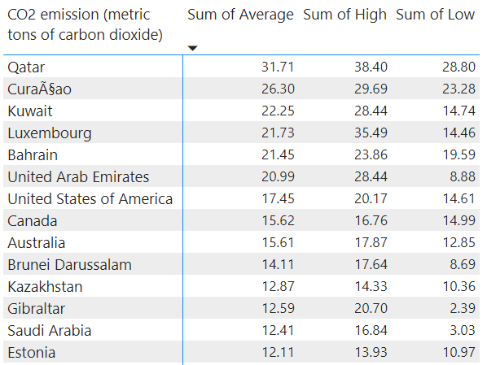
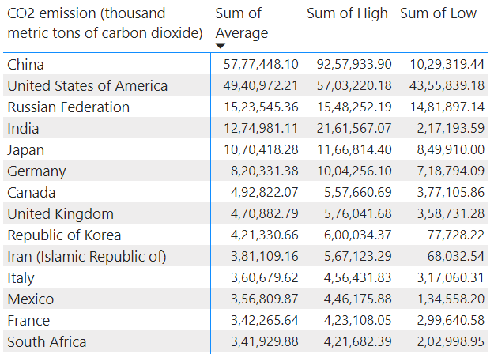
Emissions Per Capita
Total Emissions

